Slide 1
Team 05 Augmented Reality Project TCSP #03
Stephen Carlson, Steven Ellis, Alec Stephen Green, Thor Smith

Slide 2
Abstract
A multiuser augmented reality system with one or more headsets communicating via a central control unit, intended primarily for games but with other applications possible

Slide 3
Block Diagram
Headset
CCU
9DOF
Xbee
Xbee
micro
micro
GPS
Raspberry Pi
Raspberry Pi
LCD

Slide 4
PSSC
An ability to render graphics based on the orientation of the user’s head.
An ability to render graphics based on the user’s current geospatial location.
An ability to monitor and display the battery power level of the headset to the user.
An ability to monitor and display the status and quality of the wireless connection to the central control unit.
An ability to load headset graphics for a new simulation without re-flashing software on the headset’s microcontroller.

Slide 5
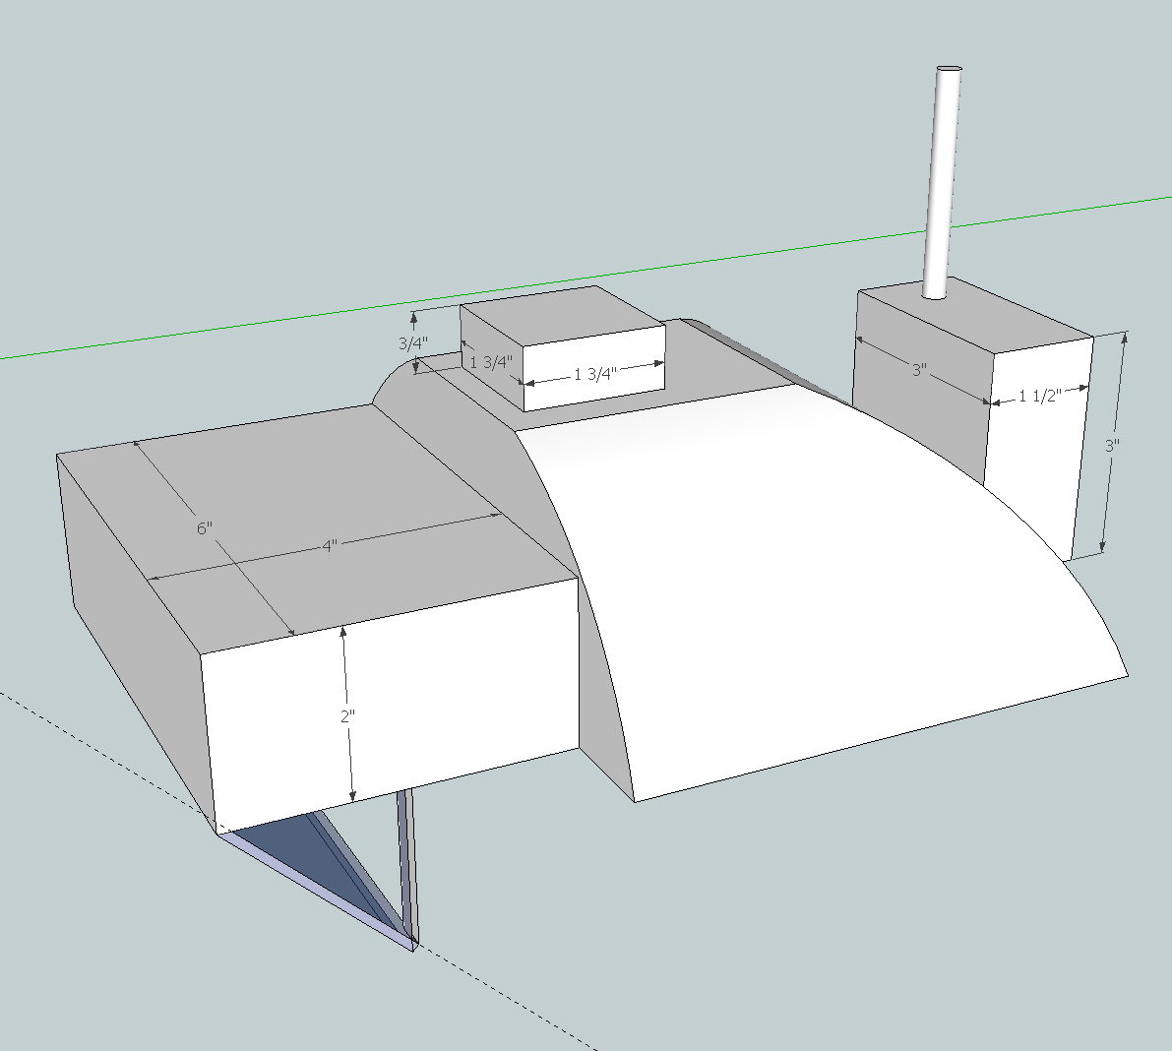

Slide 6
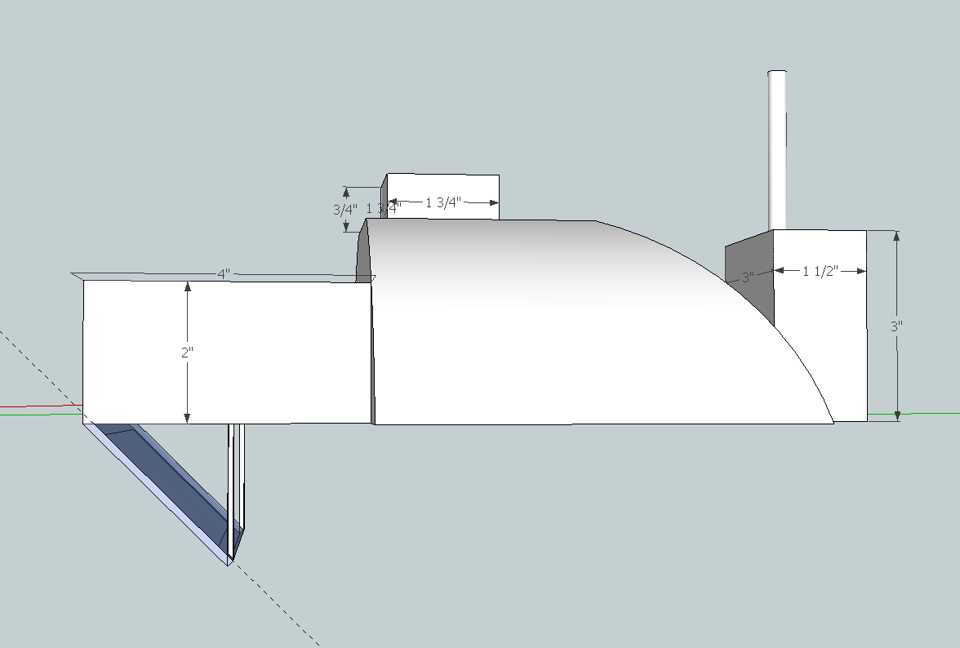

Slide 7
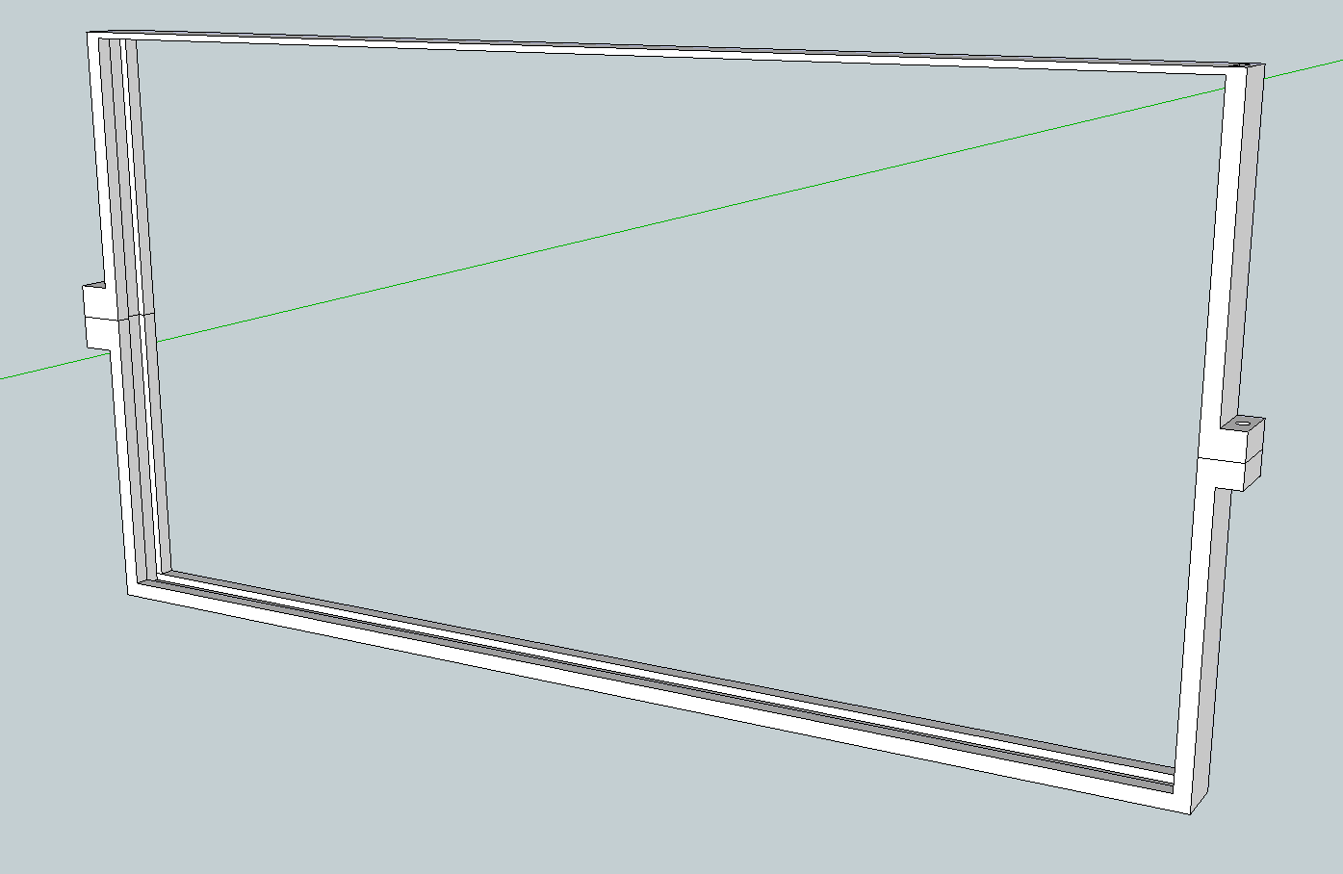

Slide 8
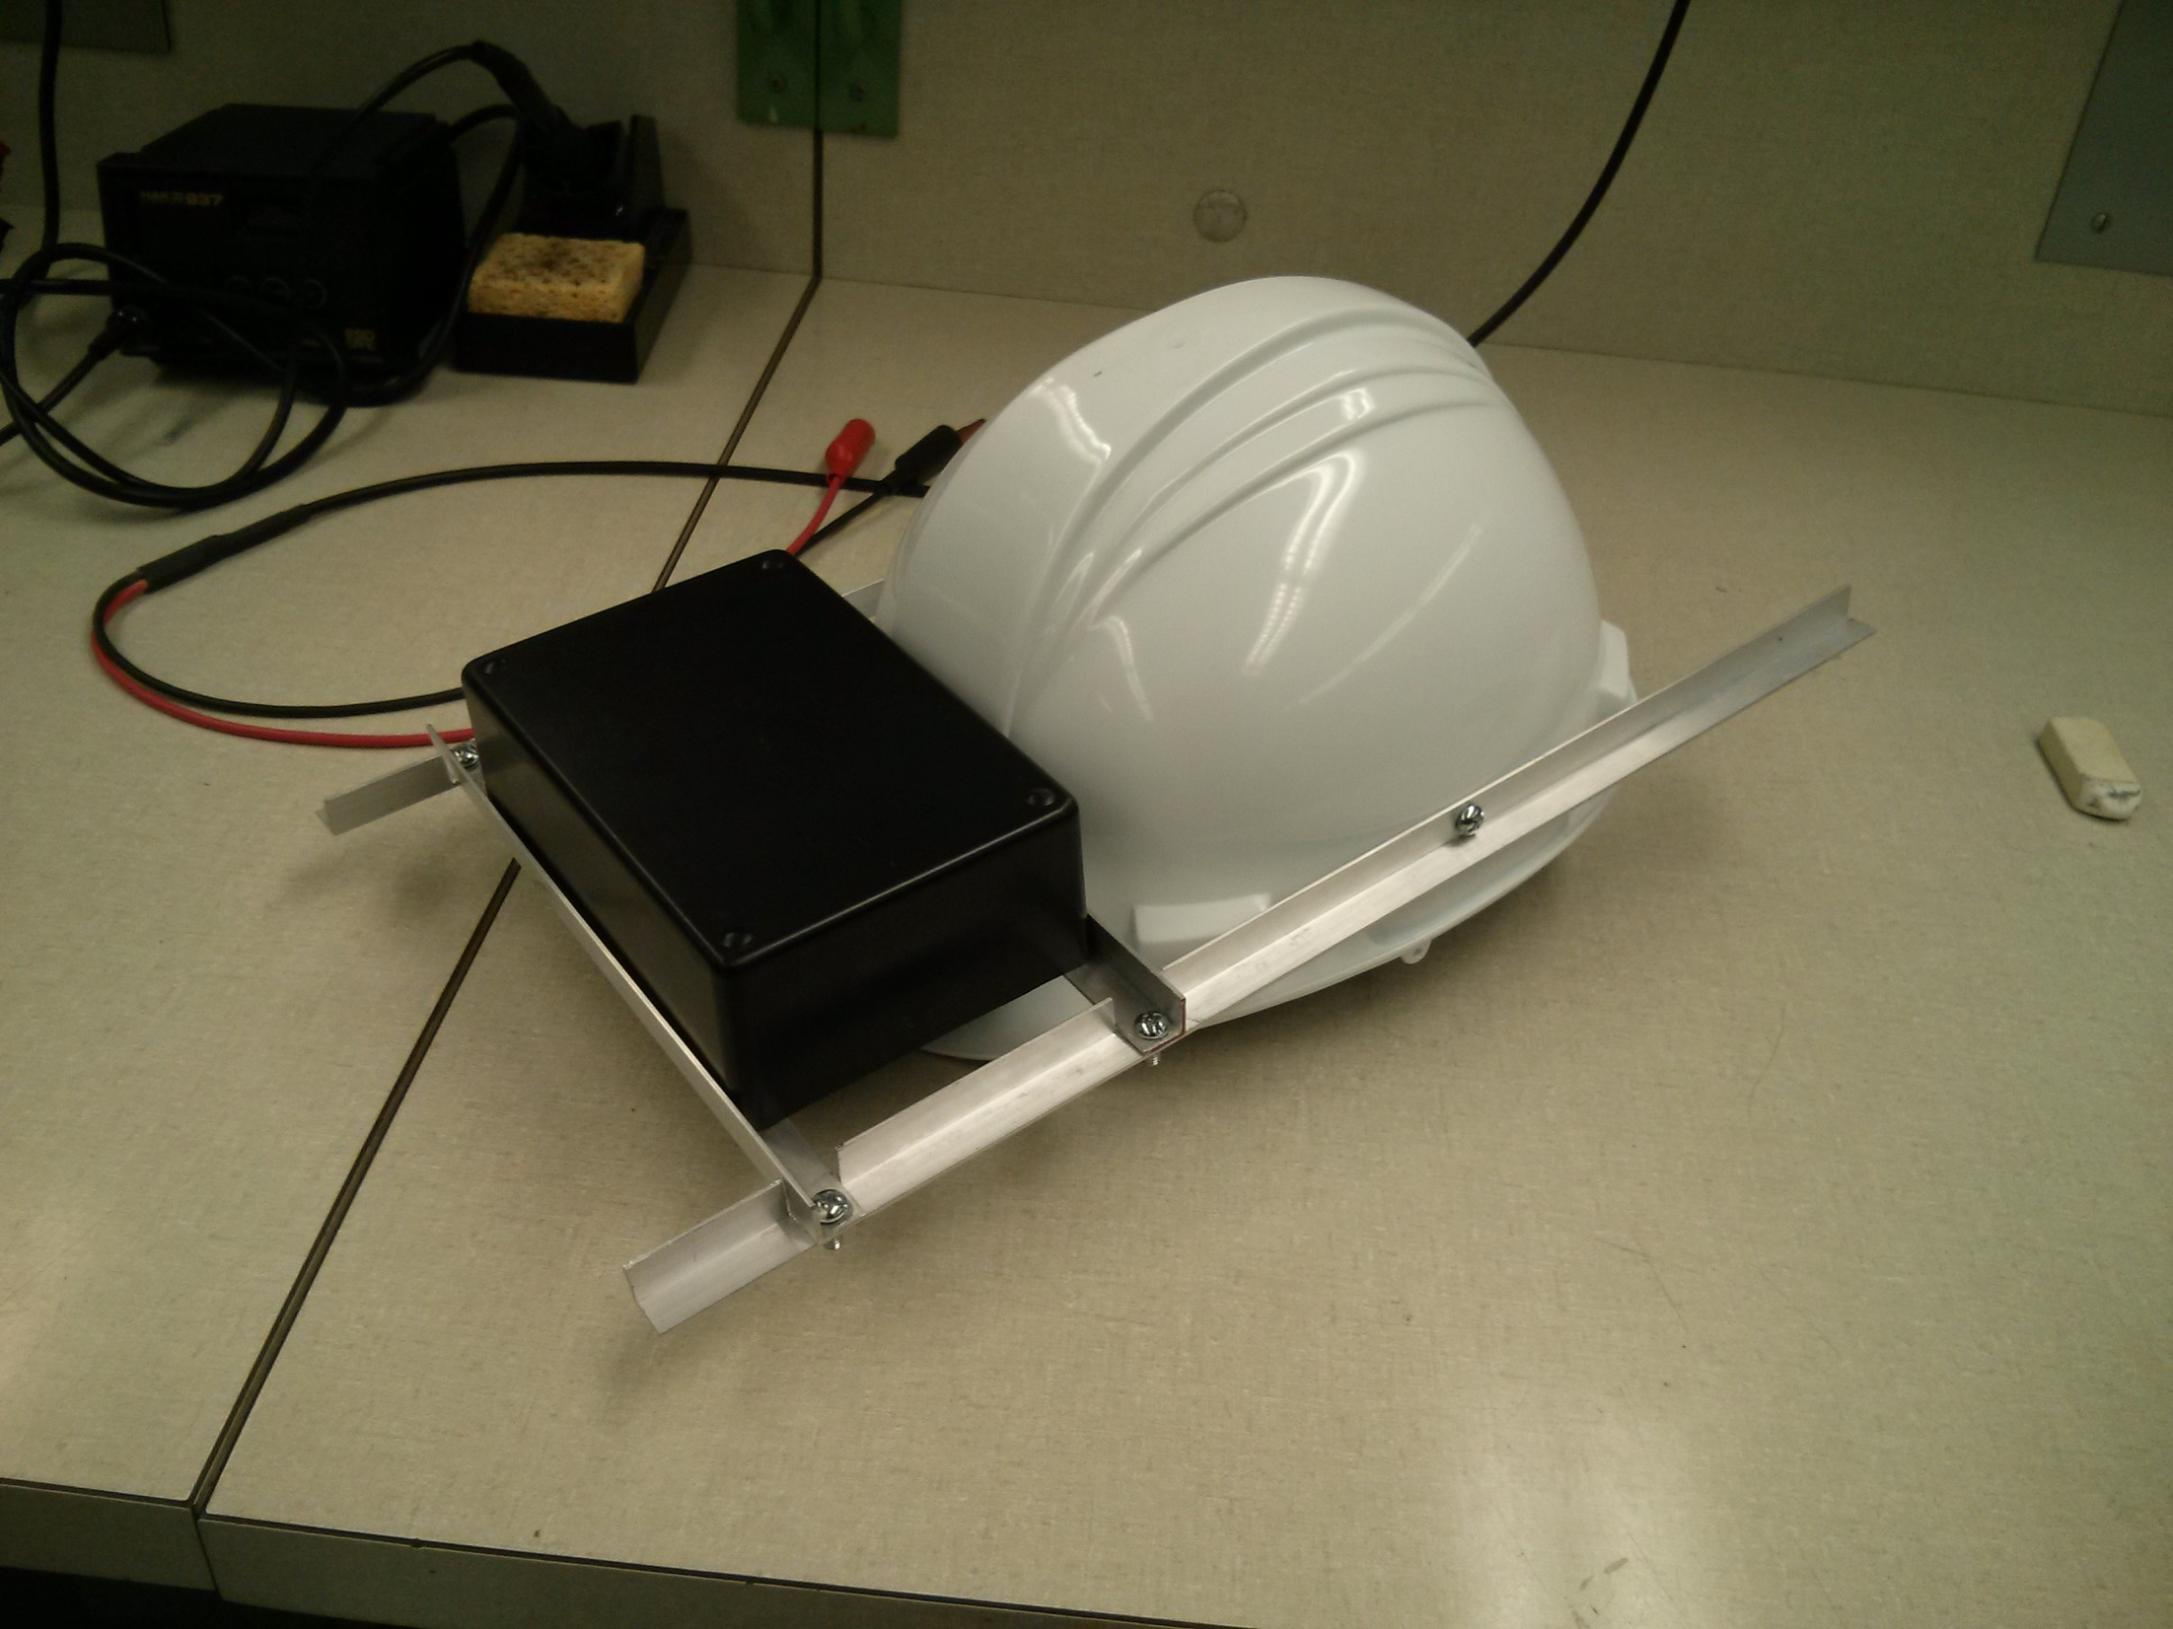

Slide 9
Materials and Tools
Hat/helmet
Boxes for display, PCB/battery stack
Angle aluminum for mounting frame
Acrylic sheet
Reflective film

